Slide 1
Introduction to using R for Spatial Analysis
Tue 1st Dec, 9:30am – 4pm
Dr Nick Bearman
@nickbearmanuk
Department of Geography and Planning

Slide 2
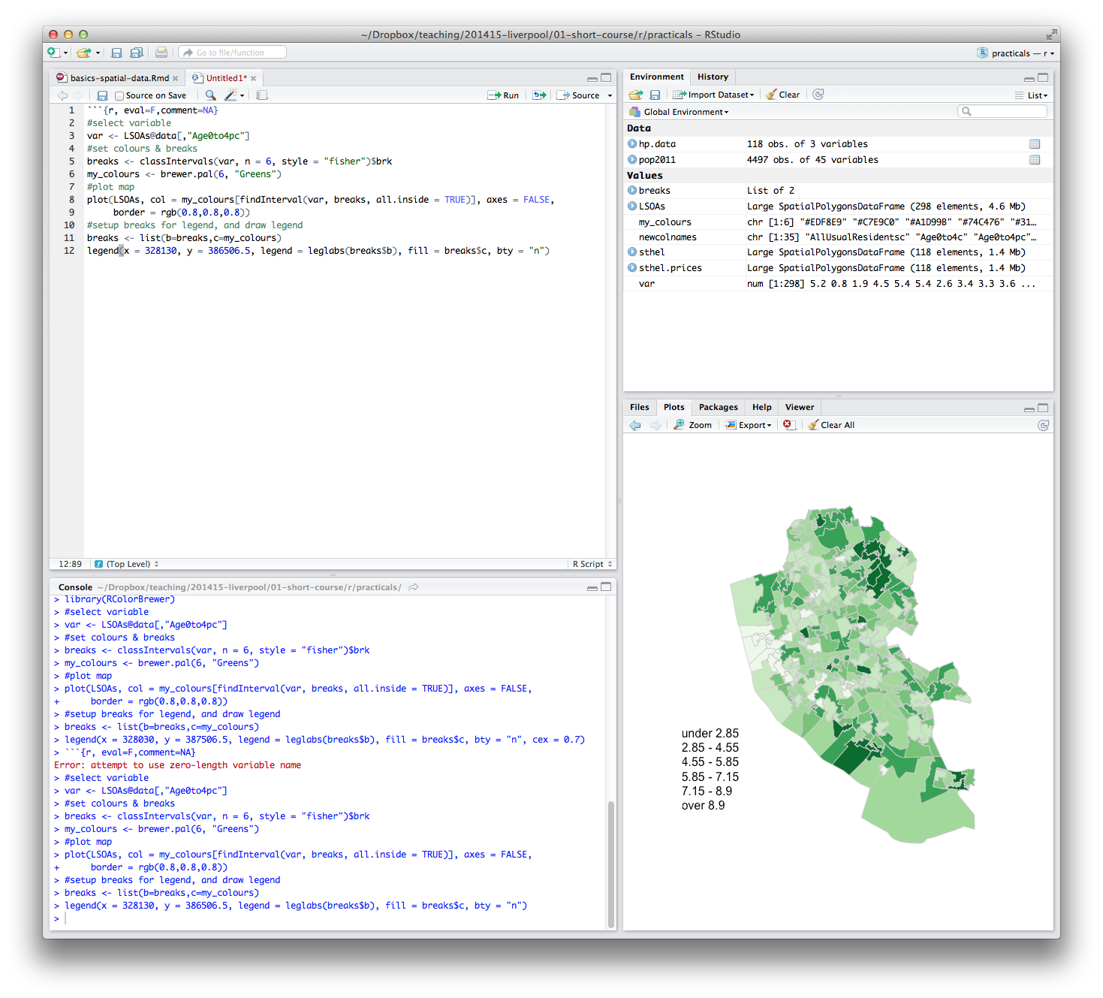
What will you get from the course?
Intros
Background on R and spatial data
Load spatial data
Basic spatial analysis

Slide 3
What will you get from the course?
Appropriate methods of visualizing data
Basic analysis
Using your own data
Presentations etc. are available online

Slide 4
Outline of the day
9:45am - 10:15am – What is GIS & R?
10:15am - 11am – Prac. 1 Intro to GIS & R
11:00am - 11:30am – Classification
11:45am - 12:30pm – Prac. 1 Intro to GIS & R
12:30pm - 1:30pm – Lunch
1:30pm - 1:45pm – Recap and Making Maps
1:45pm - 3:00pm – Practical 2 Analysis
3:00pm - 3:15pm – Coffee
3:15pm - 4pm/4:30pm – Practical 2 BYOD
Notes:
Practical 2 – Bring Your Own Data

Slide 5
Outline of the day
10:10am – 10:50am – What is GIS & R?
10:50am – 11:15am – P Intro to GIS
11:15am – 11:45am – Classification
11:45am – 12:30pm – P Classification
12:30pm – 1:15pm – Lunch
1:15pm – 2:30pm – P Making Maps
2:30pm – 2:45pm – Coffee
2:45pm – 3:30pm – P Analysis
3:30pm - 4pm – Mapping Discussion

Slide 6
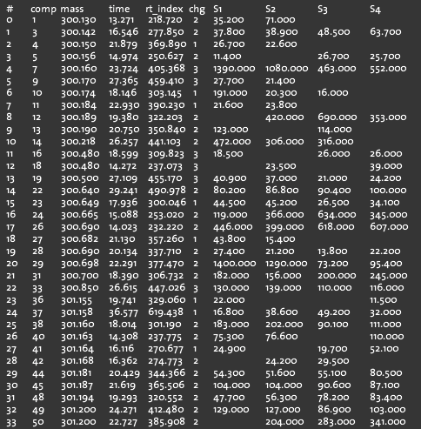
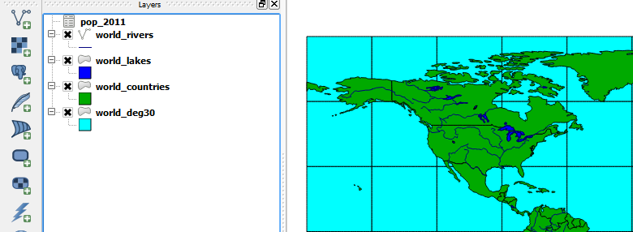
What is GIS?
Turning (spatial) data into information
Using this information to answer questions
How have housing conditions changed in the past ten years?
http://www.flickr.com/photos/dsleeter_2000/3097476532 & ESRI Course “Teaching with GIS”

Slide 7
What is GIS?
Turning (spatial) data into information
Using this information to answer questions
How have housing conditions changed in the past ten years?

Slide 8
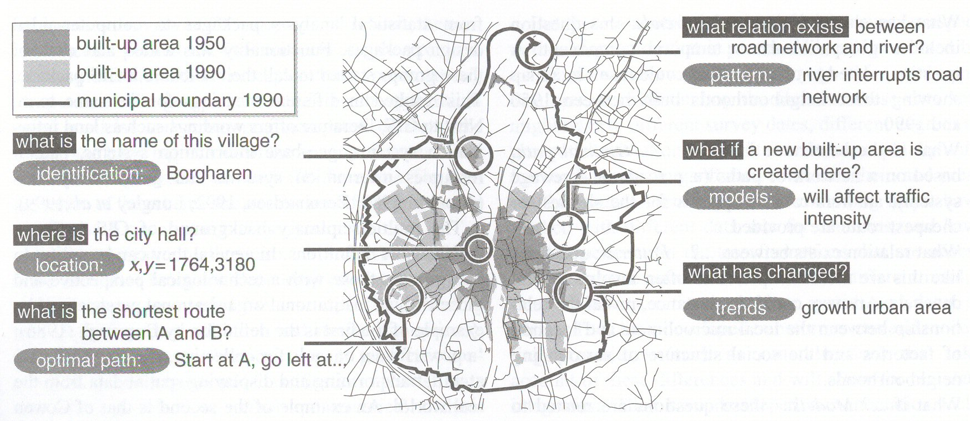
Types of questions a GIS can answer
Source: Kraak & Ormeling (2003) p.7.
Notes:
We can use a GIS for an almost infinite range of purposes, including…
-Location-based queries (e.g. where is the community centre?)
Relationship-based queries (e.g. where is the nearest Well or bore hole?)
Network analysis (e.g. what is the shortest route between A and B?)
Trend analysis (e.g. how has land use changed between time A and time B?)
3D visualisation (e.g. displaying 3d flood models)
This course will give you experience in using all three levels of using geographic information systems.

Slide 9
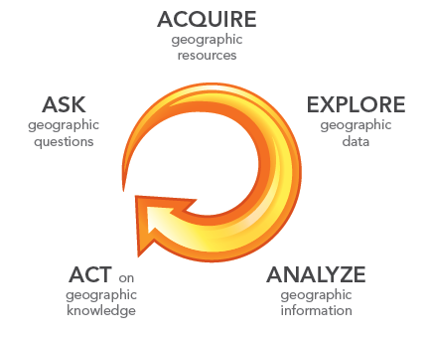
What is GIS?
http://www.flickr.com/photos/dsleeter_2000/3097476532 & ESRI Course “Teaching with GIS”

Slide 10
GIS – Geographic Information Systems
Almost all human activities and decisions involve an important geographic component
the ‘where?’
Working with geographic information involves unique, complex and difficult choices
Why we need specialized software
organize and store
access and retrieve
manipulate and synthesize
apply to the solution of problems

Slide 11
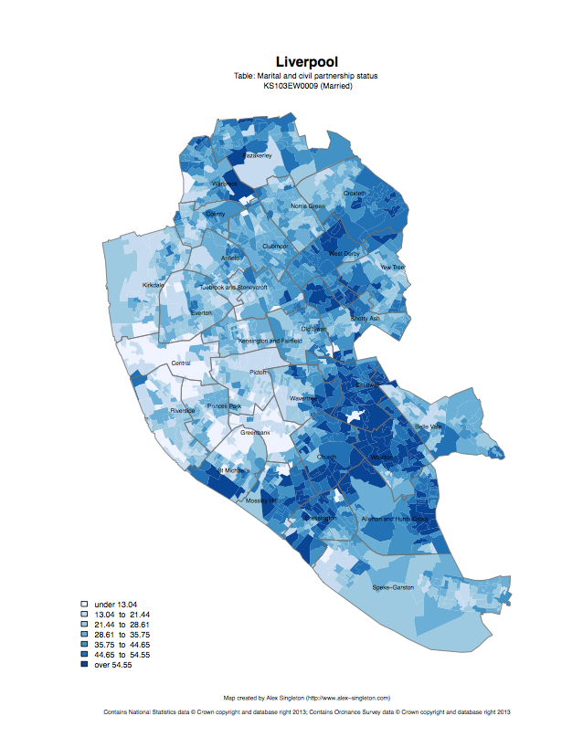
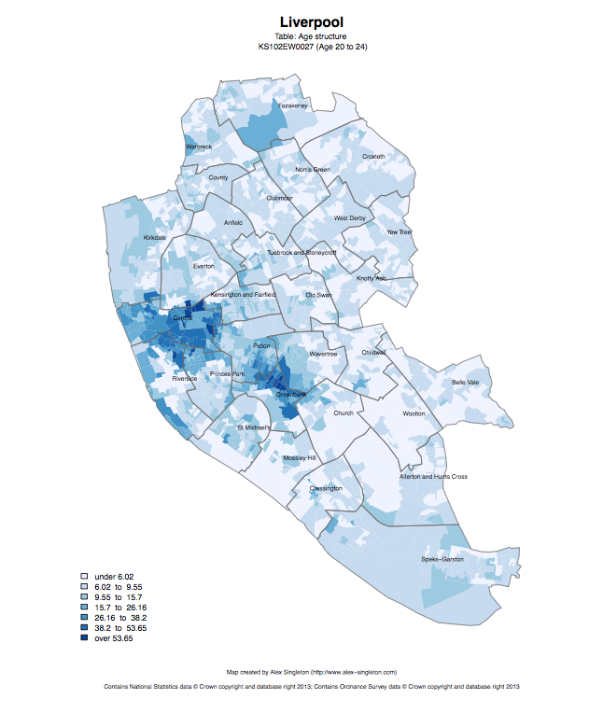
Census 2011
Married
Age structure – 20 to 24
http://www.alex-singleton.com/r/2014/02/05/2011-census-open-atlas-project-version-two/

Slide 12
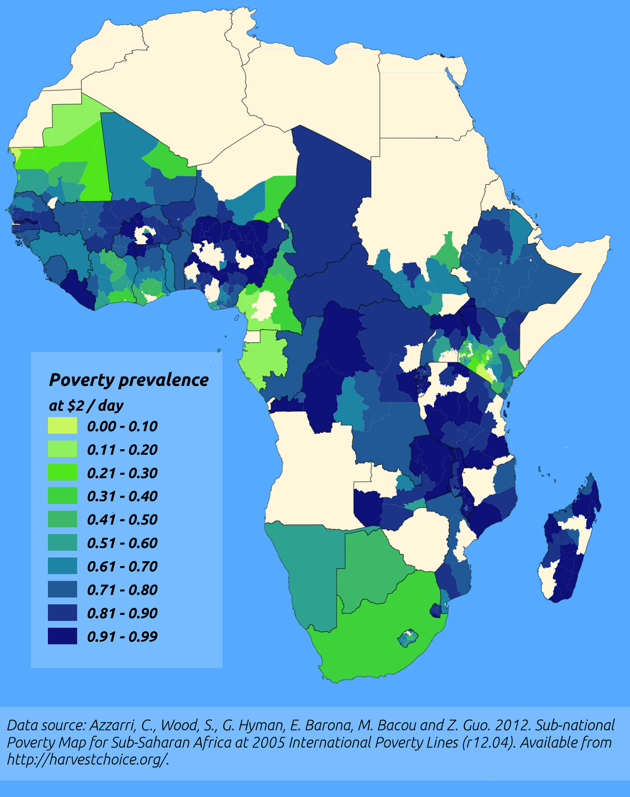
http://pvanb.wordpress.com/2012/05/09/poverty-maps-on-harvestchoice/

Slide 13





CDRC
ESRC, Getting more Information from Retail Data
Outreach – Stakeholder Users
Engagement – PhD / MSc / Training
Data and Services
Open, Safeguarded, Controlled

Slide 14
CDRC Services
Open
data.cdrc.ac.uk
maps.cdrc.ac.uk

Slide 15
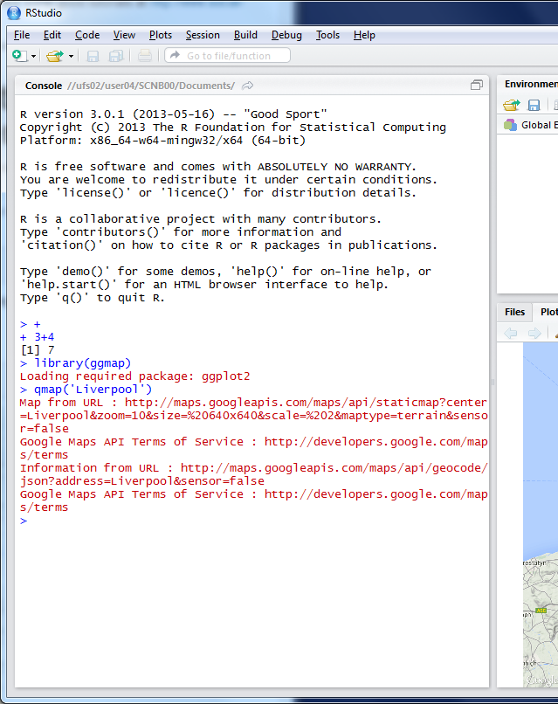


R as a GIS
Command line driven, rather than GUI
Disadvantages
Remembering commands
glossary
Steeper learning curve

Slide 16
R as a GIS
Advantages
Easy to record what you did and repeat specific pieces of work
Lots of reproducible examples on the web
Easily scriptable.
134,567 maps? easy!
2011 Census Open Atlas
http://www.alex-singleton.com/r/2014/02/05/2011-census-open-atlas-project-version-two/

Slide 17
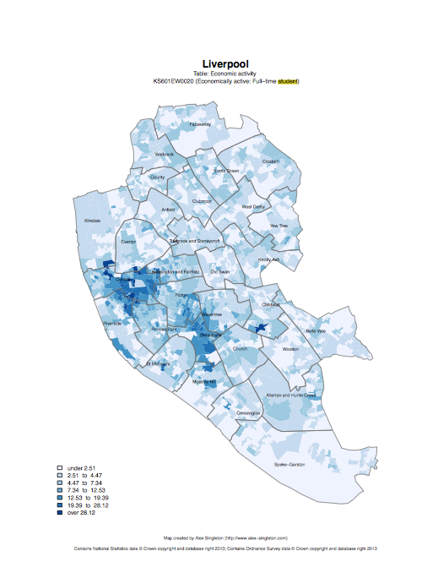

R in Action
Economically active – Full-time students

Slide 18
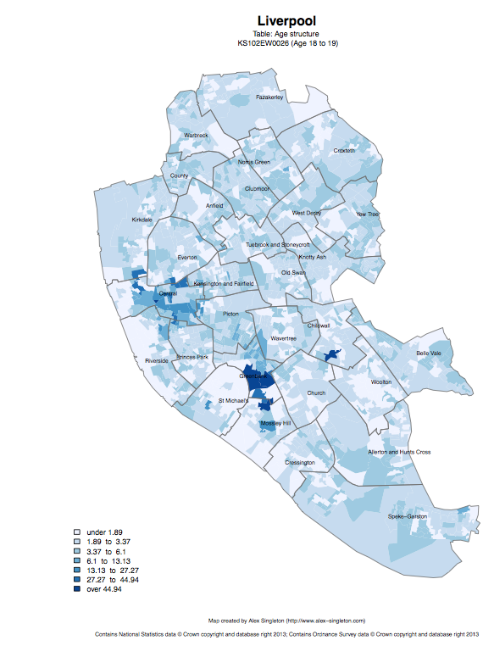
Age structure – 18 to 19
Age structure – 20 to 24

Slide 19
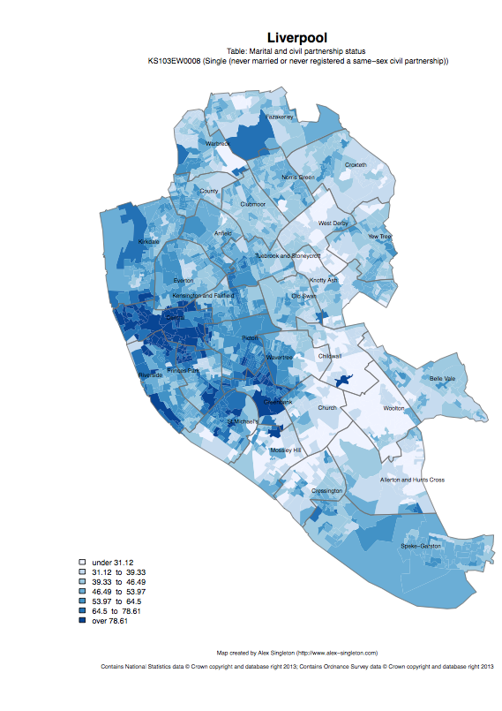
Single
Married

Slide 20
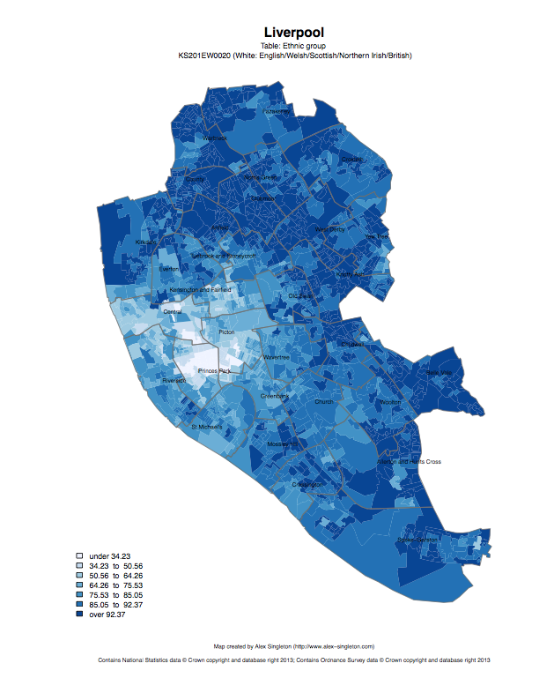
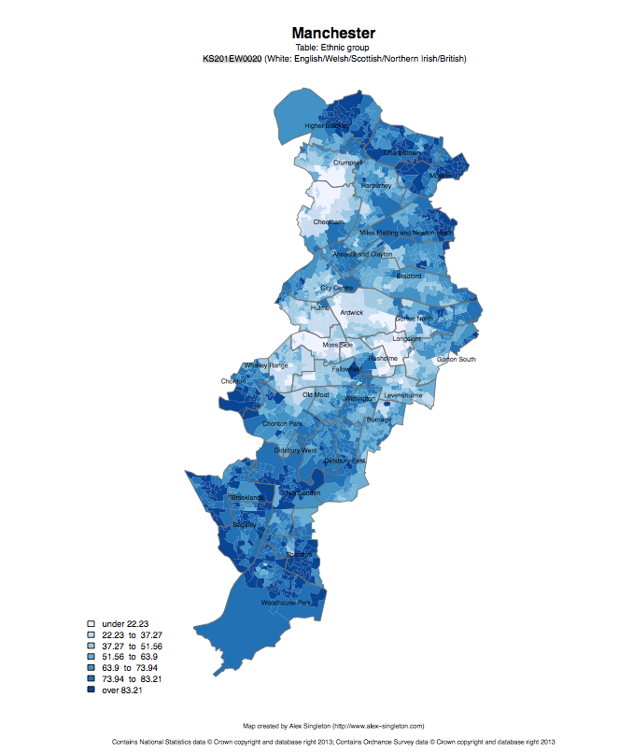
Ethnic group: white

Slide 21
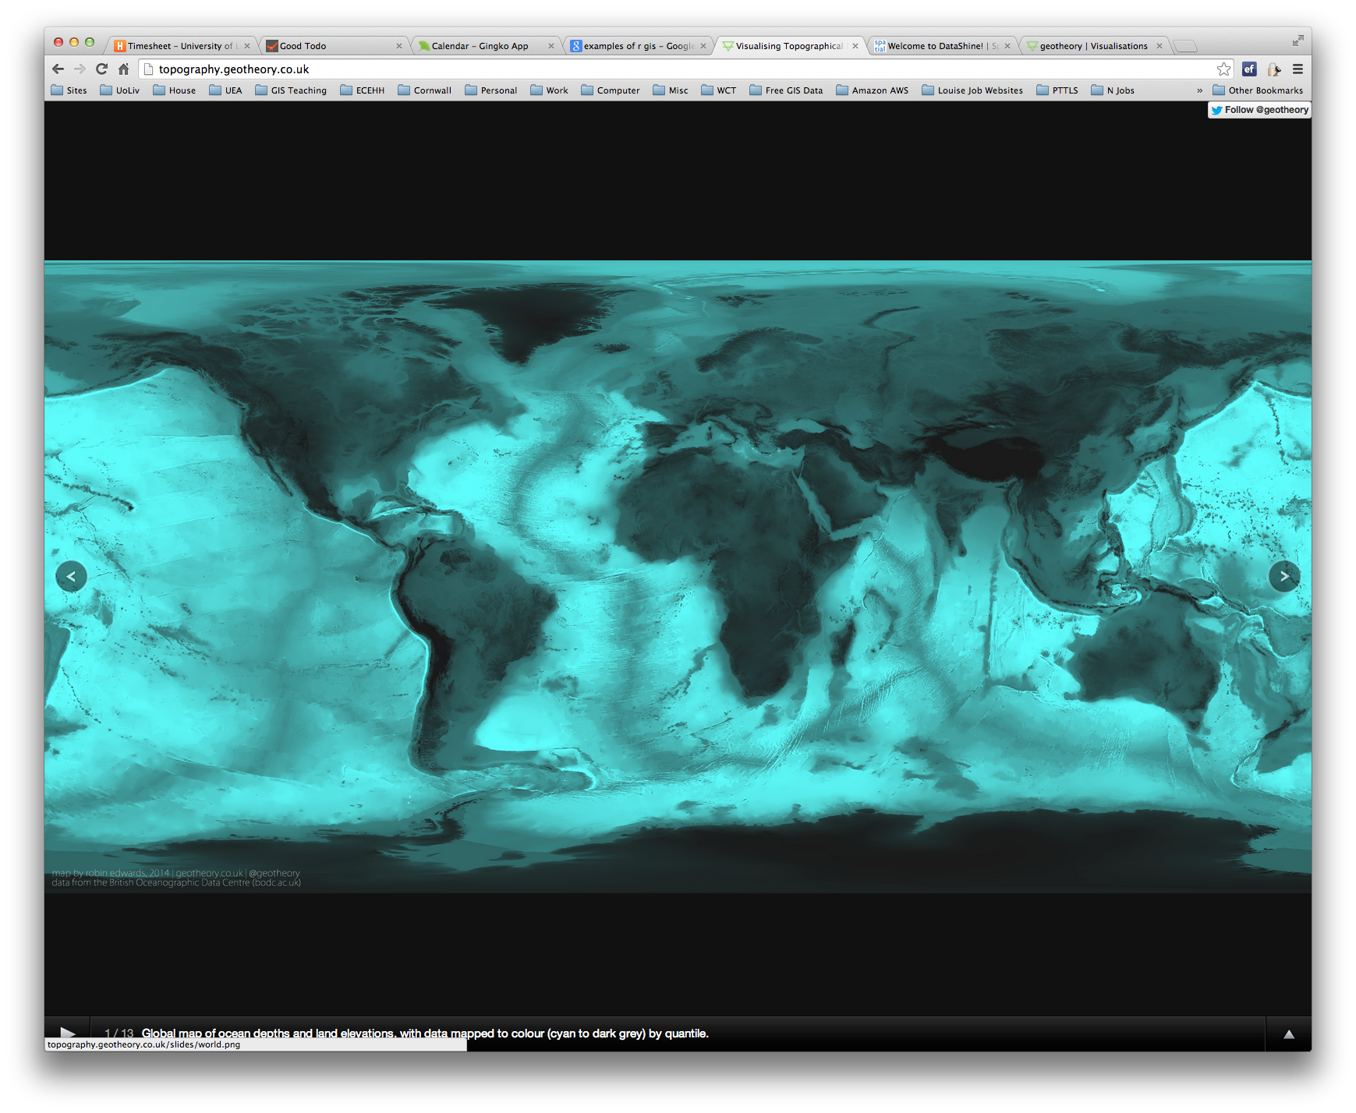
R as a GIS
Topography
http://topography.geotheory.co.uk/

Slide 22




Other GIS software?
R is very different to ArcGIS, but can do many of the same operations
R is free (as is QGIS)
R is increasingly popular in academic sector
All can be useful

Slide 23
Projections and Coordinate Systems
Who has heard of these?
Why are they important?
Latitude and Longitude (WGS 1984) 52°N 37’ 30.32’’ (52.6250) 1°E 14’ 2.05’’ (1.2339) British National Grid (Eastings & Northings) Easting: 619301 Northing: 307416

Slide 24
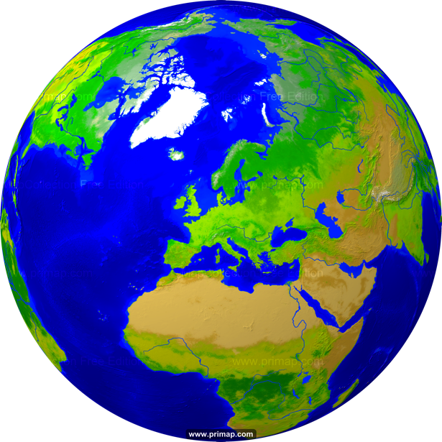
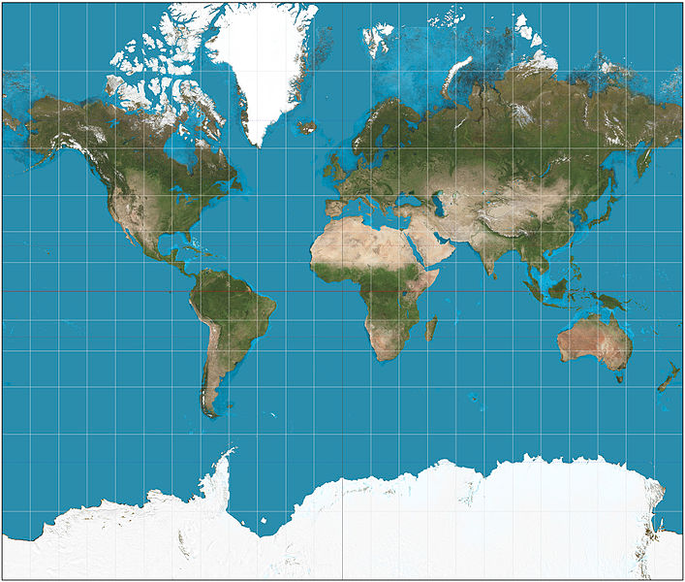
Projections
Projection – going from a sphere to a flat surface
http://www.primap.com/wsen/Maps/MapCollection/WorldMaps/Globe-(Europe-centered)-Vegetation-4000x4000.html

Slide 25


Projections
Projection – going from a sphere to a flat surface
Can’t maintain all of shape, area, angles (bearing) and distance
http://krygier.owu.edu/krygier_html/geog_353/geog_353_lo/geog_353_lo05.html
http://www.hdwallpapersos.com/orange-fruit-hd-wallpapers.html

Slide 26
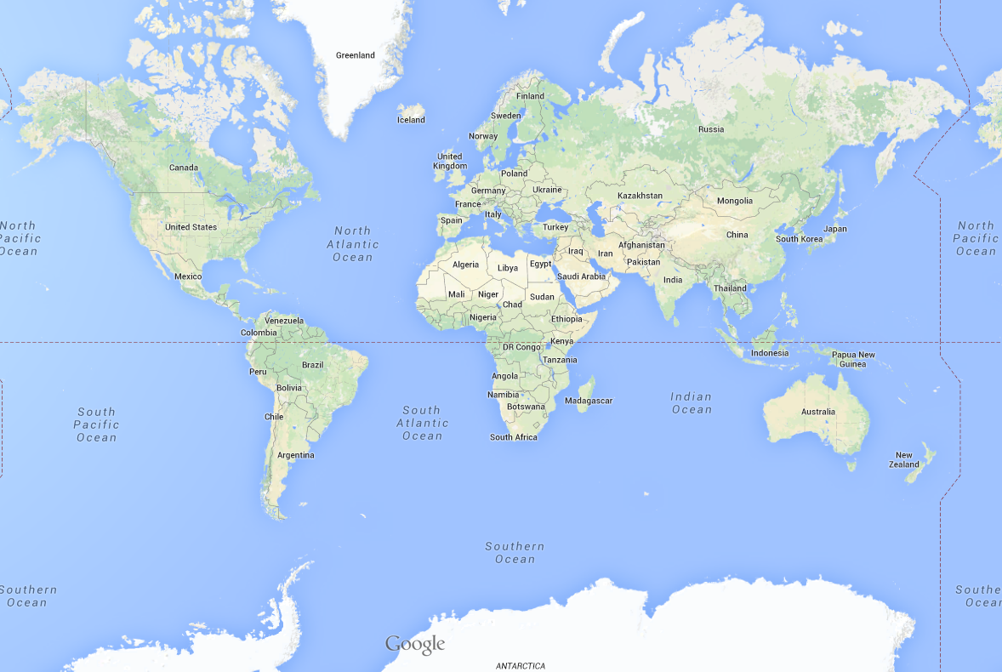
This file is licensed under the Creative Commons Attribution-Share Alike 3.0 Unported license. http://en.wikipedia.org/wiki/File:Mercator_projection_SW.jpg
Mercator projection

Slide 27
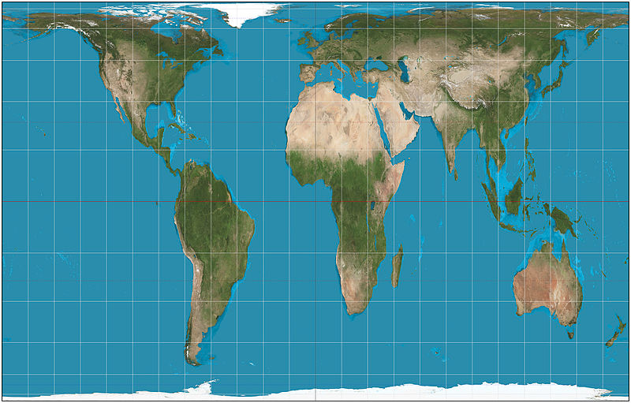
This file is licensed under the Creative Commons Attribution-Share Alike 3.0 Unported license. http://en.wikipedia.org/wiki/File:Mercator_projection_SW.jpg
Mercator projection
Peters projection
This file is licensed under the Creative Commons Attribution-Share Alike 3.0 Unported license. http://en.wikipedia.org/wiki/File:Gall%E2%80%93Peters_projection_SW.jpg

Slide 28
Africa: 30 million sq km
Greenland: 2 million sq km

Slide 29
Projections etc.
Africa: 30 million sq km
Greenland: 2 million sq km

Slide 30
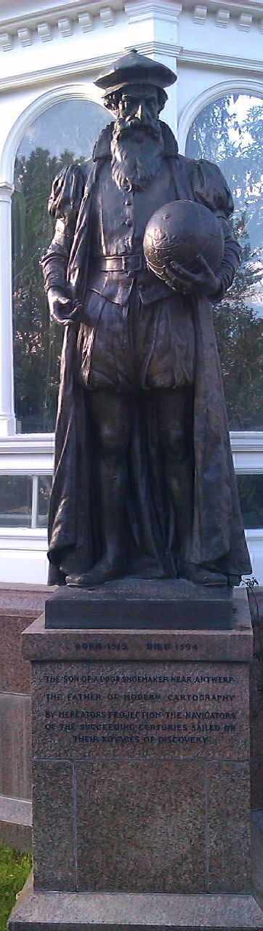
Mercator
“The Father of Modern Cartography”
By Mercator’s Projection the navigators of the succeeding centuries sailed
1569
Notes:
Maintains angle but not area.

Slide 31
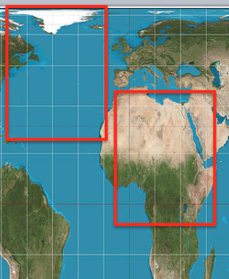
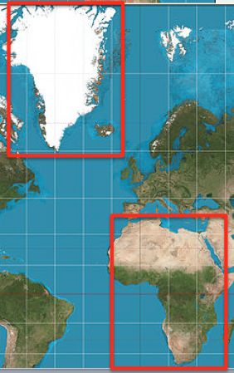
Why are Projections important?
The map(s) may not be as they appear
Data may appear in the wrong place

Slide 32
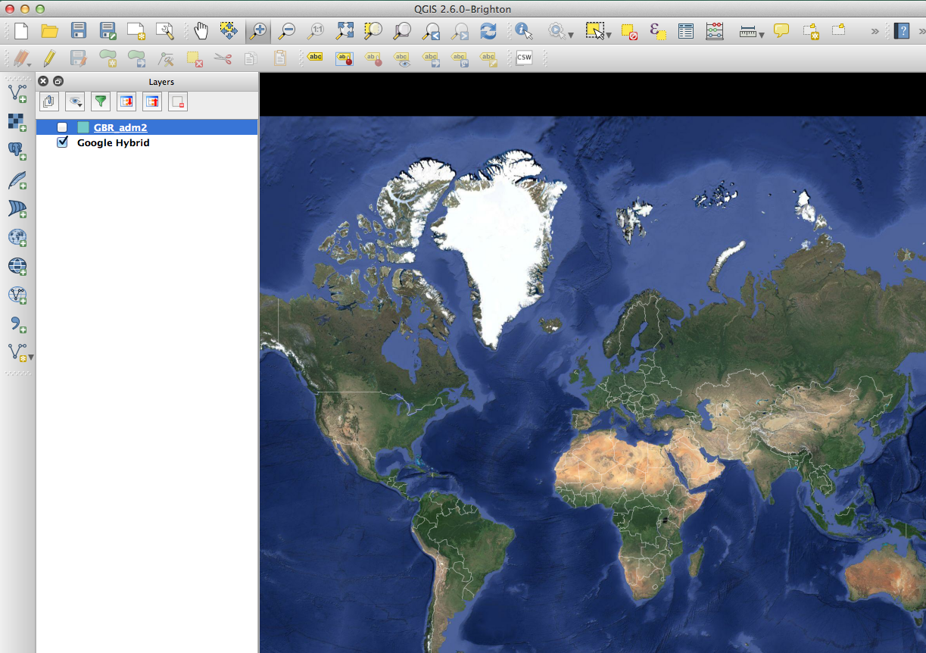

Slide 33
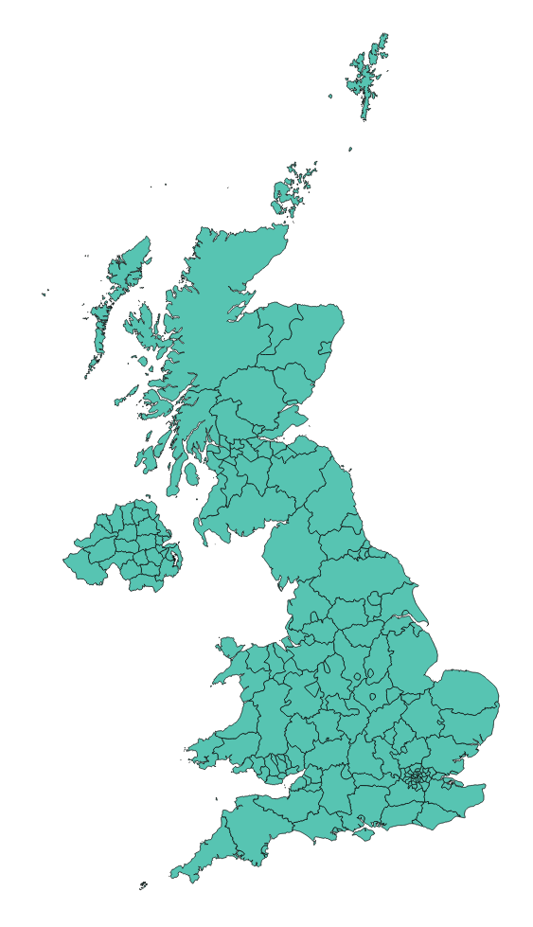

Slide 34
Why are Projections important?
The map(s) may not be as they appear
Data may appear in the wrong place
Coordinate Systems

Slide 35
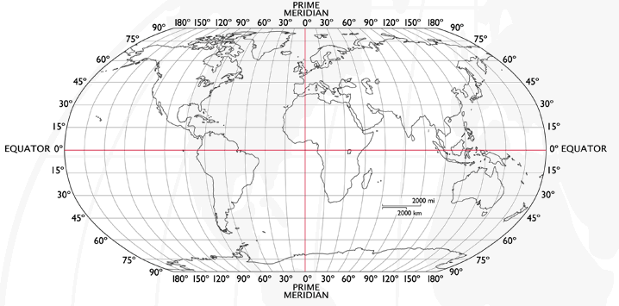
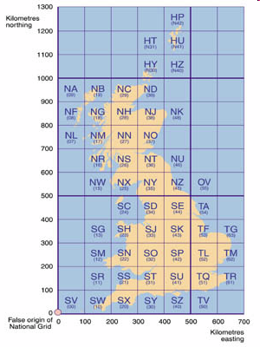
Coordinate Systems
Latitude and Longitude (WGS 1984) EPSG = 4326
52°N 37’ 30.32’’ (52.6250) 1°E 14’ 2.05’’ (1.2339)
British National Grid (Eastings & Northings)
Easting: 619301 Northing: 307416 EPSG = 27700
Why is it important?
Some data uses uses WGS84
LSOA use BNG (Eastings/Northings)
Need to convert between the two
Notes:
-Coordinate Systems are derived from projections and are used to give coordinates (numbers) to locations on the Earth’s surface
-Best if your data is all in the same coordinate system (otherwise the coordinates might be slightly different for the same location), but ArcMap can convert between them
-Most common:
-Lat/Long (also WGS 1984) used by most GPS
-BNG (British National Grid) very common in UK data – Ordnance Survey format.
-Most important – are all your data in the same coordinate system?
-ArcMap can convert, but often if your data appears in the wrong place, it is because there is something wrong with the coordinate system.
http://www.worldatlas.com/webimage/testmaps/latslongs.htm
http://www.ordnancesurvey.co.uk/oswebsite/gps/information/coordinatesystemsinfo/guidetonationalgrid/page13.html
http://www.ordnancesurvey.co.uk/oswebsite/gps/information/coordinatesystemsinfo/guidetonationalgrid/page8.html

Slide 36
Joining
Area ID
1
2
3
4
5
14
7
8
11
Area ID | Deprivation
1 | High
2 | High
3 | High
4 | Average
5 | Average
6 | Average
7 | Low
8 | Low
9 | Low
10 | High
11 | Low
12 | High
13 | High
14 | Average
15 | Average
1
2
3
14
4
7
5
8
11
Data
Polygons
Lookup

Slide 37
1
Area ID | Deprivation
1 | High
2 | High
3 | High
4 | Average
5 | Average
14 | Average
7 | Low
8 | Low
11 | Low
2
3
14
4
7
5
8
11
High Deprivation
Average Deprivation
Low Deprivation

Slide 38
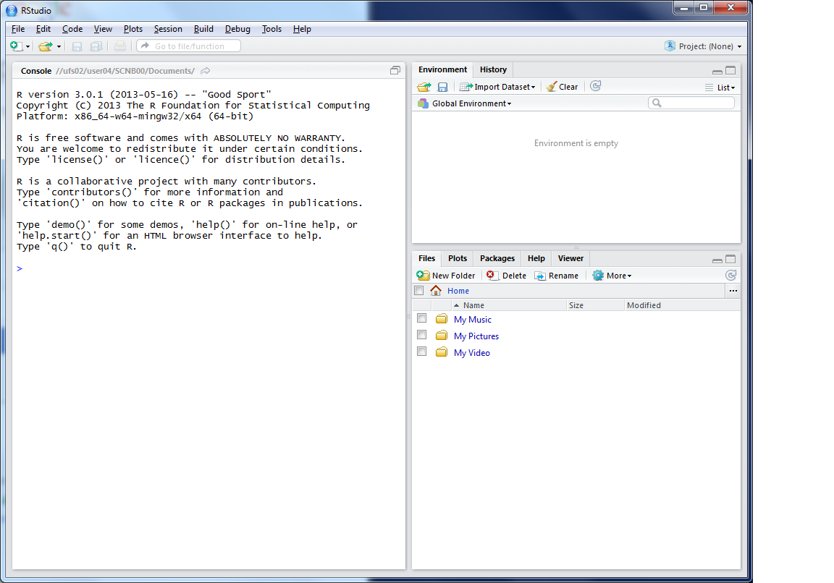
This lists the variables you have
This is the console where you can type in commands
Here will show either your files (the files tab) or your plots (the plots tab)

Slide 39
Working Directory
R uses a ‘working directory’ to store your files in
You might have a different one for each project / piece of work
e.g. M:\Documents\GIS
setwd(“M:/Documents/GIS”)

Slide 40
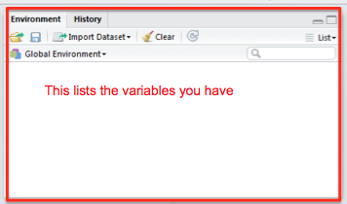
Variables
R uses variables to store information – listed in your ‘workspace’ (top-right)
When you close R Studio, save workspace
house.prices <- c(120,150,212, 99,199,299,159)

Slide 41
Variables and Assignments
house.prices
<-
c(120,150,212,99,199,299,159)

Slide 42
Variables and Assignments
house.prices
<-
c(120,150,212,99,199,299,159)

Slide 43
Variables and Assignments
house.prices
<-
c(120,150,212,99,199,299,159)

Slide 44
Variables and Assignment
motorways
<-
readShapeSpatial('meridian-2/ motorway_polyline’, proj4string = CRS("+init=epsg:27700"))
See glossary for details

Slide 45
Variables and Assignment
motorways
<-
readShapeSpatial('meridian-2/ motorway_polyline’, proj4string = CRS("+init=epsg:27700"))
See glossary for details

Slide 46
Variables and Assignment
motorways
<-
readShapeSpatial('meridian-2/ motorway_polyline’, proj4string = CRS("+init=epsg:27700"))
See glossary for details

Slide 47
Variables and Assignment
motorways
<-
readShapeSpatial('meridian-2/ motorway_polyline’, proj4string = CRS("+init=epsg:27700"))
See glossary for details
Case sensitive
Motorways ≠ motorways ≠ mOtOrWaYs

Slide 48
Data Formats
Data frames are like a table or spreadsheet
dataframe[rows,cols]
dataframe[1,] first row
dataframe[,1] first col

Slide 49
Practical Approach
(Primarily) self-led practical
Good to explore the options
Ask questions as we go through
Try things
Use the help ?command

Slide 50
Typing out Code
Log on
Why do I make you type out code?
Helps the learning process
Make you think about what the code does
(but you can copy/paste long bits)
Optional Exercises
Red and Green post-its
Breaks

Slide 51
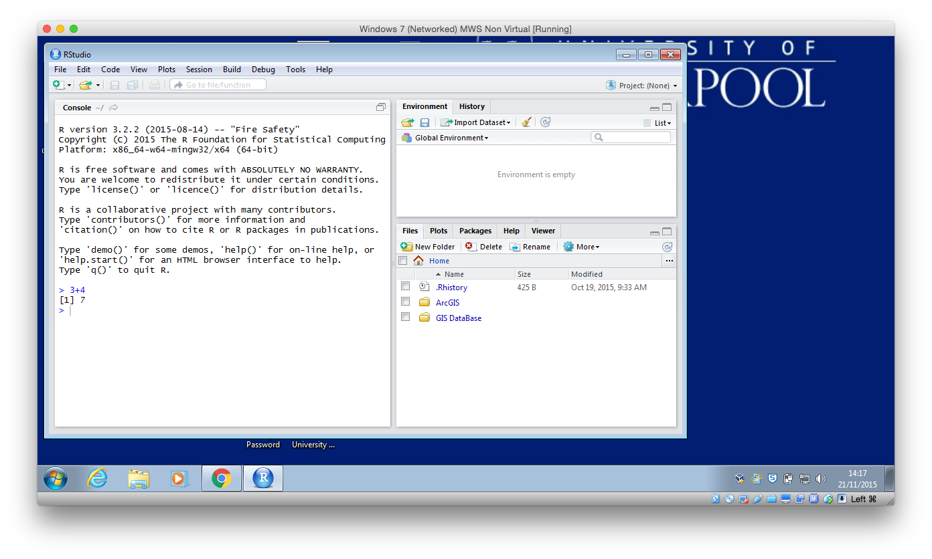
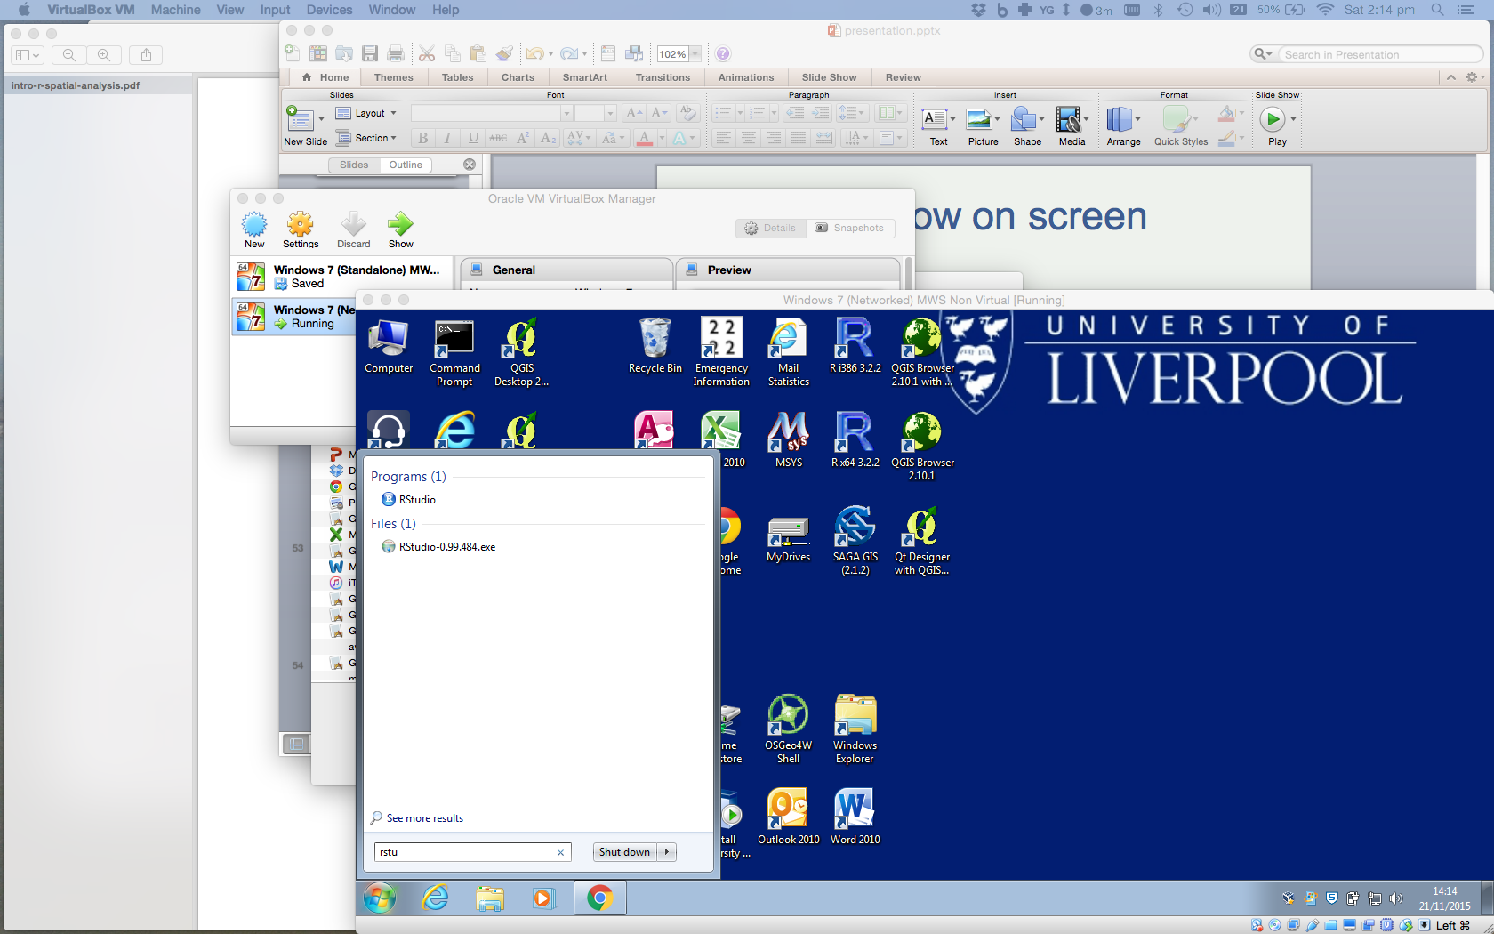
Load R

Slide 53
Outline of the day
9:45am - 10:15am – What is GIS & R?
10:15am - 11am – Prac. 1 Intro to GIS & R
11:00am - 11:30am – Classification
11:45am - 12:30pm – Prac. 1 Intro to GIS & R
12:30pm - 1:30pm – Lunch
1:30pm - 1:45pm – Recap and Making Maps
1:45pm - 3:00pm – Practical 2 Analysis
3:00pm - 3:15pm – Coffee
3:15pm - 4pm/4:30pm – Practical 2 BYOD
Notes:
Practical 2 – Bring Your Own Data

Slide 54
Outline of the day
10:10am – 10:50am – What is GIS & R?
10:50am – 11:15am – P Intro to GIS
11:15am – 11:45am – Classification
11:45am – 12:30pm – P Classification
12:30pm – 1:15pm – Lunch
1:15pm – 2:30pm – P Making Maps
2:30pm – 2:45pm – Coffee
2:45pm – 3:30pm – P Analysis
3:30pm - 4pm – Mapping Discussion

Slide 55
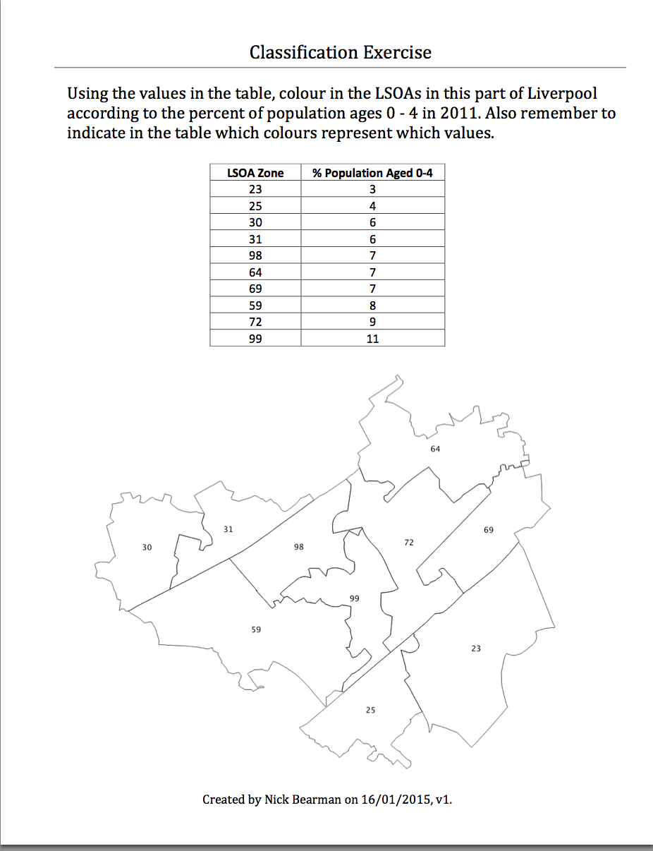
Classification
Colour in the values for Age (10 min)
Discuss your choices

Slide 56
Classification
Colour in the values for Age (10 min)
Discuss your choices
Colours
Classes

Slide 57
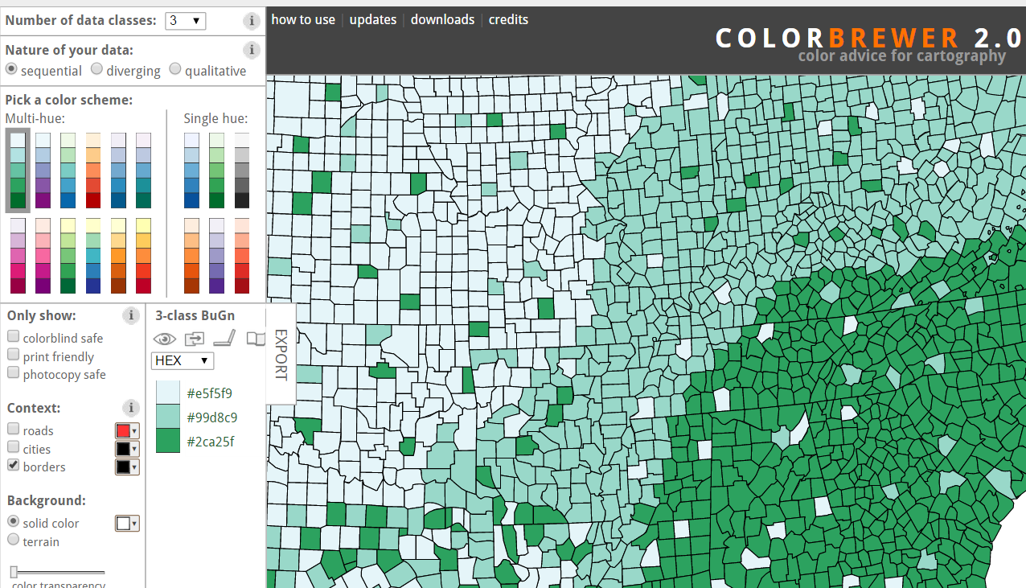
Map Design: Classification
Choropleth maps have colours
How do you choose the colours?
Why is this important?
Output
User
colorbrewer.org

Slide 58
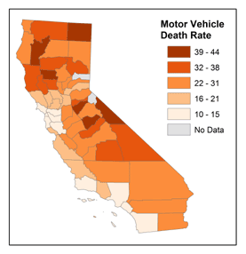
Map Design: Classification
Choropleth maps have classes
How do you choose the classes?
Why is this important?
© 2014 The Pennsylvania State University, https://www.e-education.psu.edu/geog486/l4_p7.html#classification_schemes

Slide 59
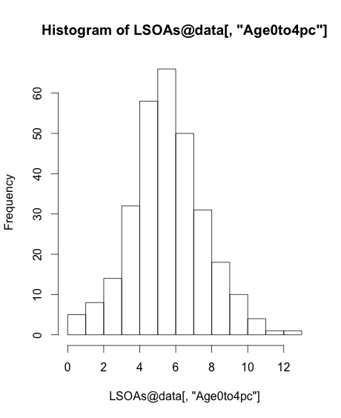
Map Design: Classification
[,"Age0to4pc"]

Slide 60
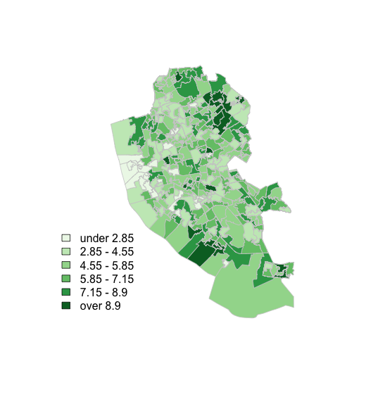
Map Design: Classification

Slide 61
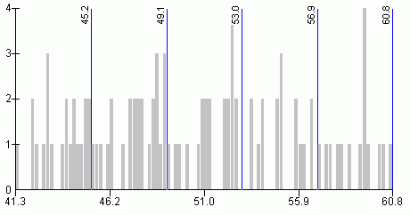
Map Design: Classification
s
http://www.directionsmag.com/entry/choropleth-mapping-with-exploratory-data-analysis/123579

Slide 62
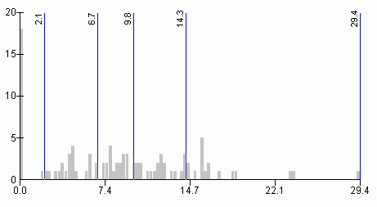
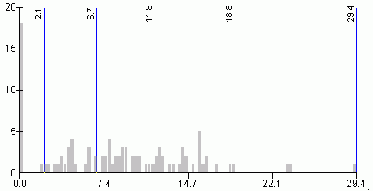
Quantiles
- “equal sized data subsets”
sN
Natural Breaks
reduce variance within class
increase variance between classes
http://www.directionsmag.com/entry/choropleth-mapping-with-exploratory-data-analysis/123579

Slide 63
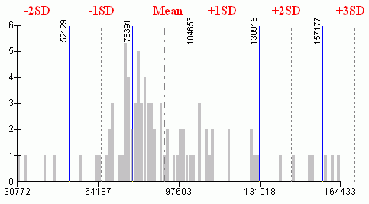
sN
Standard Deviation
R has:
fixed
sd
equal
pretty
quantile
fisher
jenks
….
(from ?classIntervals)
http://www.directionsmag.com/entry/choropleth-mapping-with-exploratory-data-analysis/123579

Slide 64
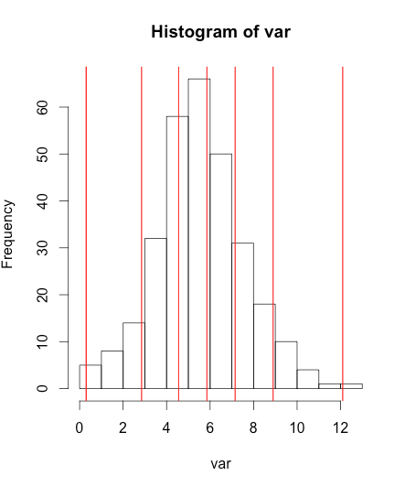
Can do this in R
var <- LSOA@data[,"Age0to4pc"]
breaks <- classIntervals(var, n = 6, style = "fisher")
hist(var)
abline(v = breaks$brks, col = "red")

Slide 65
Can do this in R
var <- LSOA@data[,"Age0to4pc"]
breaks <- classIntervals(var, n = 6, style = "fisher")
hist(var)
abline(v = breaks$brks, col = "red")

Slide 66
Can do this in R
var <- LSOA@data[,"Age0to4pc"]
breaks <- classIntervals(var, n = 6, style = "fisher")
hist(var)
abline(v = breaks$brks, col = "red")

Slide 67
Can do this in R
var <- LSOA@data[,"Age0to4pc"]
breaks <- classIntervals(var, n = 6, style = "fisher")
hist(var)
abline(v = breaks$brks, col = "red")

Slide 68
Can do this in R
var <- LSOA@data[,"Age0to4pc"]
breaks <- classIntervals(var, n = 6, style = "fisher")
hist(var)
abline(v = breaks$brks, col = "red")

Slide 69
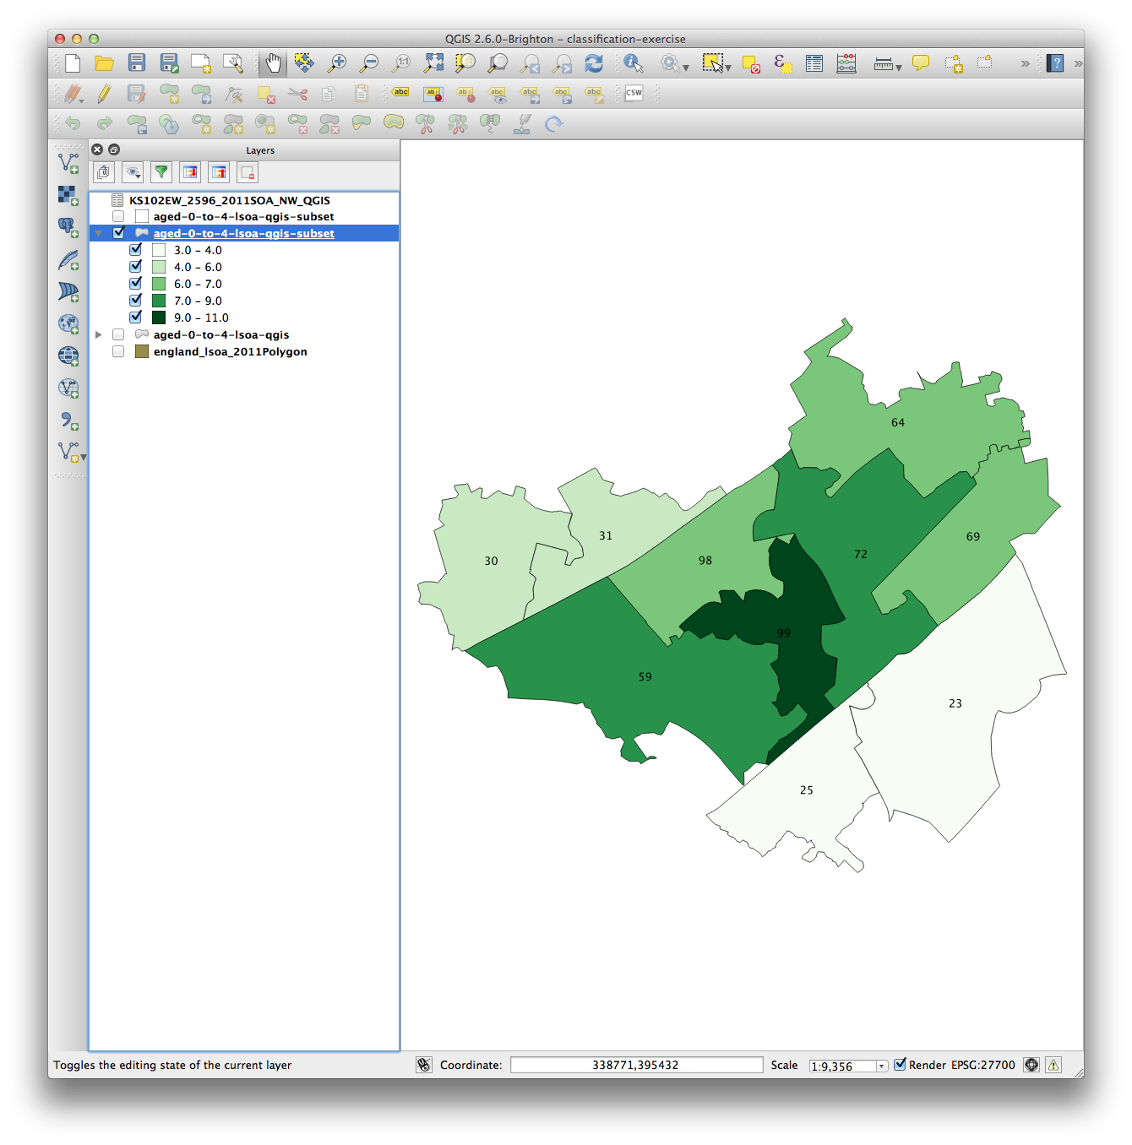
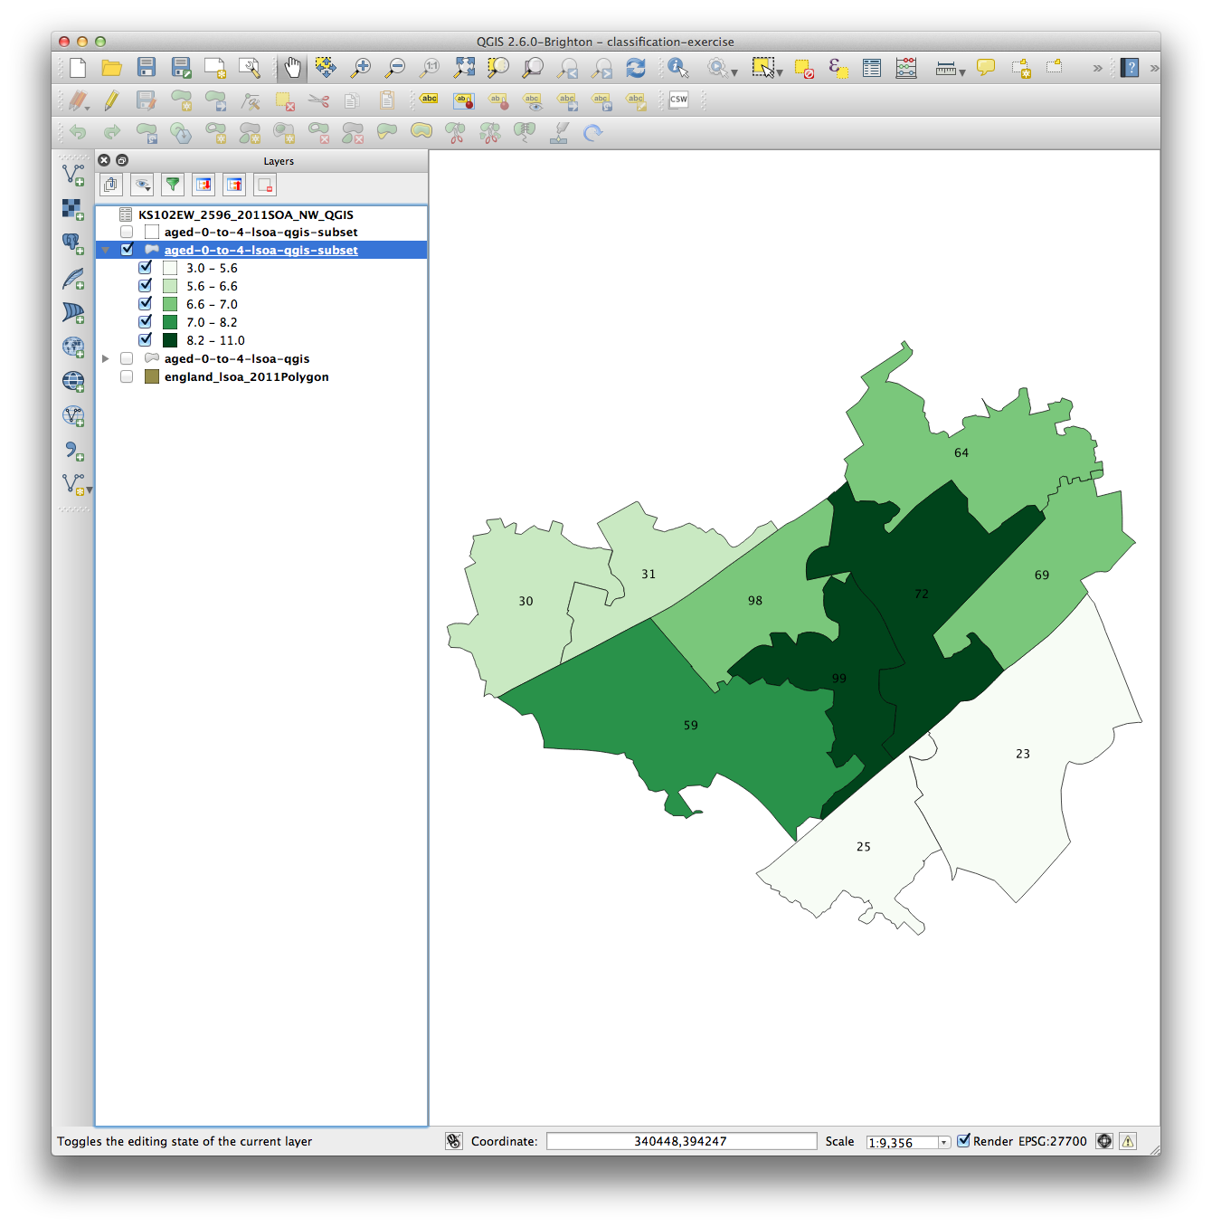
Why is it important?
Age 0-4
Natural Breaks
Quantile

Slide 70
Why is it important?
Age 0-4
Natural Breaks
Quantile

Slide 71
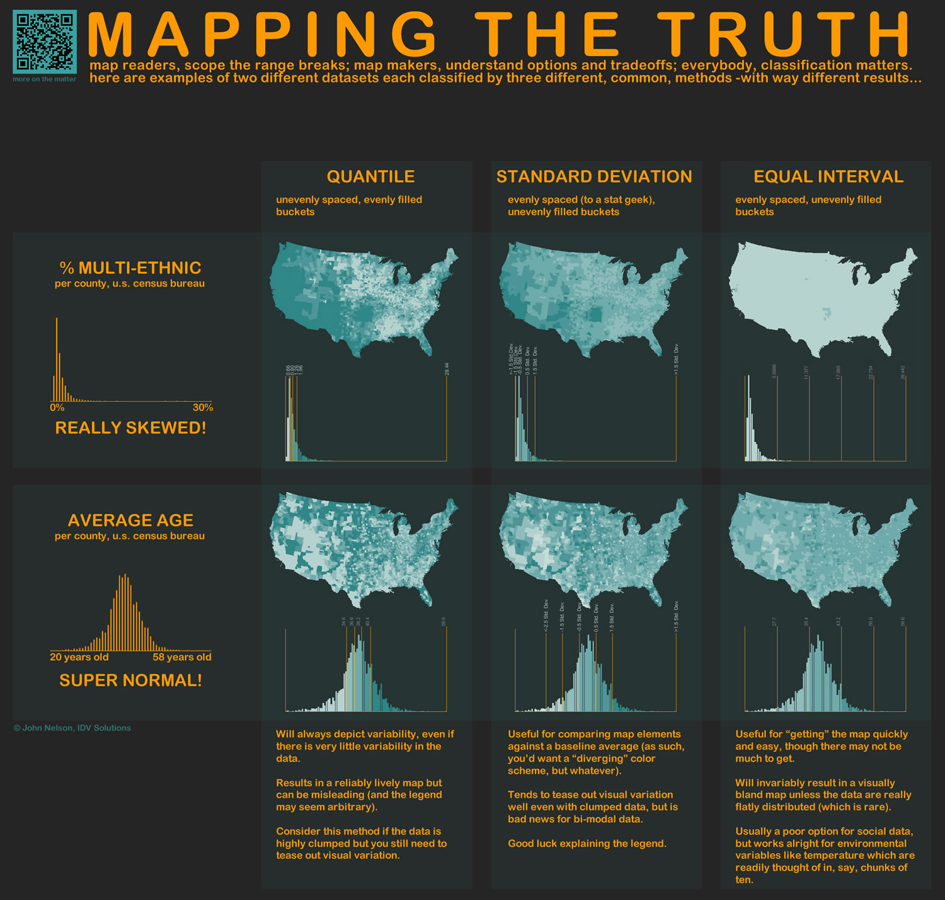
http://www.flickr.com/photos/idvsolutions/6691496421/in/photostream/

Slide 72
http://uxblog.idvsolutions.com/2011/10/telling-truth.html

Slide 73
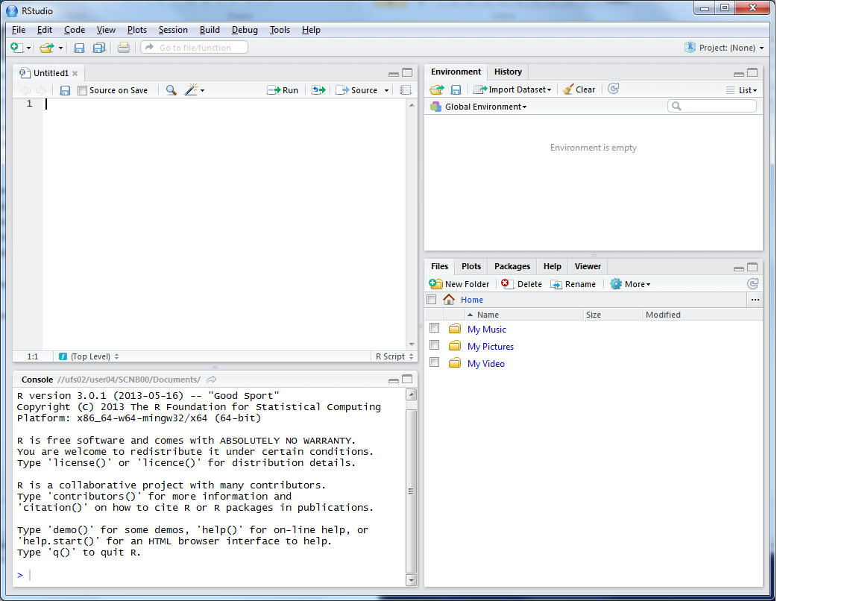
R Scripts
Why use scripts?
Easier to correct code
Can easily re run sections of code, or all code if you need to start again
Good to enable you to reload data etc. if you move machines, or don’t have your workspace saved

Slide 74
This is where you can write scripts
This lists the variables you have
Link to survey:
Here will show either your files (the files tab) or your plots (the plots tab)
This is the console where you can type in commands

Slide 75
Ctrl-Enter to run line/selection

Slide 76
Projects
RStudio supports projects
Ties together the workspace (data) and script files.
Saves as a .RProj file
Use a project when you start the next section

Slide 77
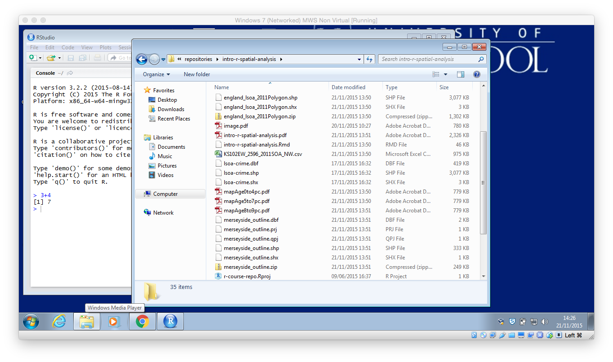
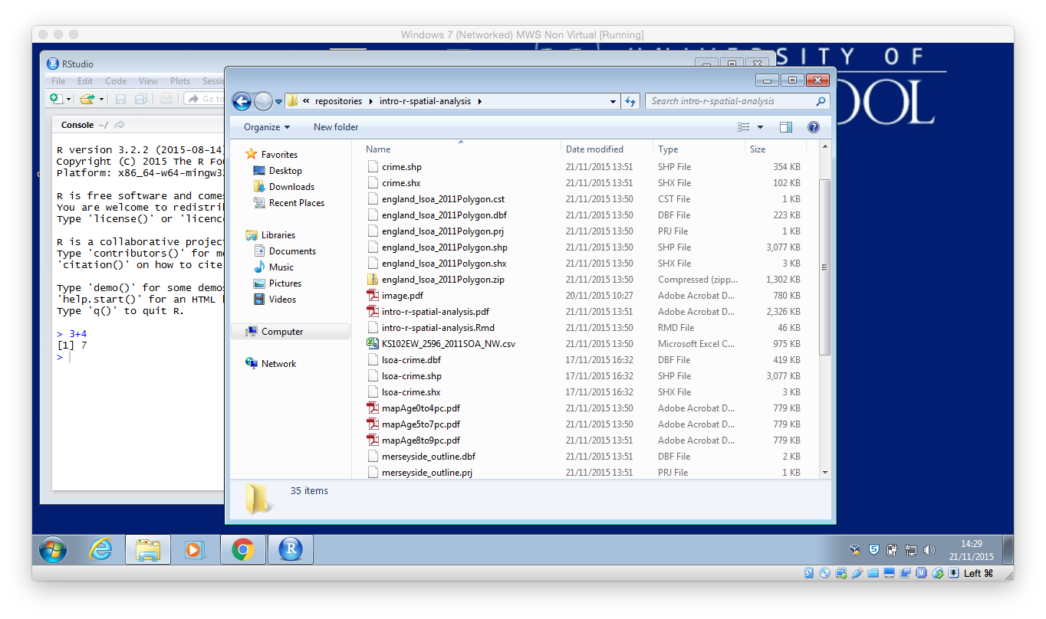
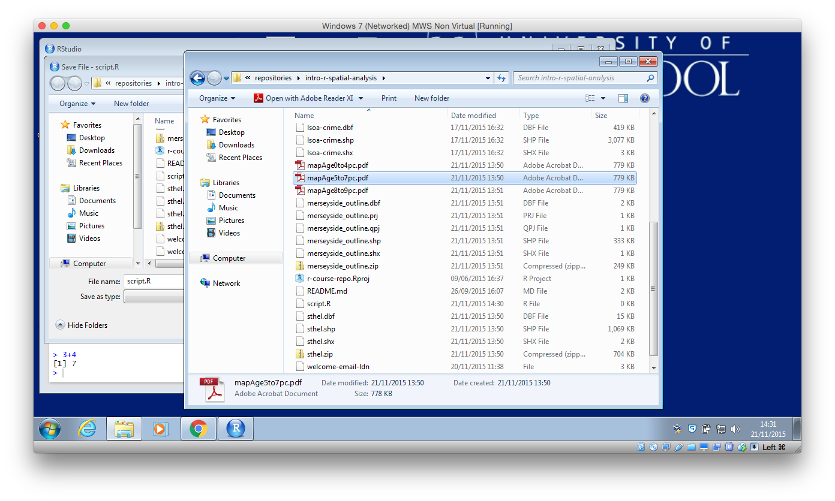
Files

Slide 78
Shape Files
.shp the geometry (polygons) themselves
.shx extra geometry information
.dbf attribute information (dBase IV format)
.prj projection & coordinate system info
.cst text encoding
https://en.wikipedia.org/wiki/Shapefile
Notes:
Wikipedia can tell you more than you ever wanted to know about Shape file formats!

Slide 79
Code recap
Useful tips
Up arrow in the console shows you the previous command
History contains a history of all commands
Plot window has a back arrow, and an export option
Scripts

Slide 80
Code debugging
R error messages can be cryptic
Remember
case sensitive
picky about , [ ] ( )
typos
Error in getinfo.shape(fn) : Error opening SHP file can’t find shapefile
Error: could not find function "readShapeSpatial” can’t find function
See glossary helpsheet – and let me know what to add!

Slide 82
Outline of the day
9:45am - 10:15am – What is GIS & R?
10:15am - 11am – Prac. 1 Intro to GIS & R
11:00am - 11:30am – Classification
11:45am - 12:30pm – Prac. 1 Intro to GIS & R
12:30pm - 1:30pm – Lunch
1:30pm - 1:45pm – Recap and Making Maps
1:45pm - 3:00pm – Practical 2 Analysis
3:00pm - 3:15pm – Coffee
3:15pm - 4pm/4:30pm – Practical 2 BYOD
Notes:
Practical 2 – Bring Your Own Data

Slide 83
Outline of the day
10:10am – 10:50am – What is GIS & R?
10:50am – 11:15am – P Intro to GIS
11:15am – 11:45am – Classification
11:45am – 12:30pm – P Classification
12:30pm – 1:15pm – Lunch
1:15pm – 2:30pm – P Making Maps
2:30pm – 2:45pm – Coffee
2:45pm – 3:30pm – P Analysis
3:30pm - 4pm – Mapping Discussion

Slide 84
Lunch

Slide 85
Outline of the day
9:45am - 10:15am – What is GIS & R?
10:15am - 11am – Prac. 1 Intro to GIS & R
11:00am - 11:30am – Classification
11:45am - 12:30pm – Prac. 1 Intro to GIS & R
12:30pm - 1:30pm – Lunch
1:30pm - 1:45pm – Recap and Making Maps
1:45pm - 3:00pm – Practical 2 Analysis
3:00pm - 3:15pm – Coffee
3:15pm - 4pm/4:30pm – Practical 2 BYOD
Notes:
Practical 2 – Bring Your Own Data

Slide 86
Outline of the day
10:10am – 10:50am – What is GIS & R?
10:50am – 11:15am – P Intro to GIS
11:15am – 11:45am – Classification
11:45am – 12:30pm – P Classification
12:30pm – 1:15pm – Lunch
1:15pm – 2:30pm – P Making Maps
2:30pm – 2:45pm – Coffee
2:45pm – 3:30pm – P Analysis
3:30pm - 4pm – Mapping Discussion

Slide 87
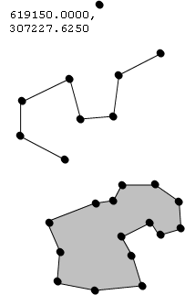
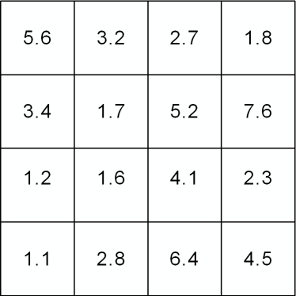

Vector and Raster data
Points, Lines & Polygons
Grid Based
Road networks
Rivers and lakes
Street addresses or postcodes
Administrative areas/boundaries
Elevation
Temperature
Land cover
Population density
Light reflectance (in the form of satellite or aerial imagery)
Notes:
-Raster data is constructed by surveying or sampling at regular intervals on a grid layout.
e.g. soil sample every 500m, or interpolated (estimated) from contours.
-Usually assigned a colour in GIS. Includes images, aerial photos.
-You can convert data between the different formats quite easily in the software for different applications

Slide 88
Data Structure – Slot Names
Slot Names slotNames(LSOA)
"data"
"polygons"
"bbox"
"proj4string"

Slide 89
Data Structure – Slot Names
Slot Names slotNames(LSOA)
"data” ”polygons” "bbox" "proj4string”
LSOA@data
LSOA@data$LSOA_CODE
@ and $
Try running
LSOA@proj4string

Slide 90
Code recap
Scripts
Highlight: click Run or Ctrl-Enter

Slide 91
Code recap
Plotting Maps
plot(LSOA,
col = my_colours[findInterval (var, breaks, all.inside = TRUE)],
axes = FALSE,
border = rgb(0.8,0.8,0.8))

Slide 92
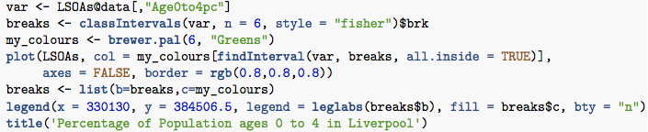
Making Maps from Census Data
Same as before

Slide 93

Making Maps from Census Data
Same as before, … but:
Save as PDF

Slide 94

Making Maps from Census Data
Same as before, … but:
Save as PDF & Loop

Slide 95
Making Maps from Census Data

Slide 96

Plotting Multiple Maps
plot(crime.pts, pch='.', col='darkred')
plot(LSOA, add = TRUE)

Slide 97
Point in Polygon
Points = Crimes
Polygons = LSOA

Slide 98
Overlays / Intersection
Many types, often depends on data type
gContains – wholly within
gOverlaps – overlaps (not necessarily completely within)

Slide 99

gContains

Slide 100

gContains

Slide 101

gOverlaps

Slide 102


Slide 103
Practical
Feedback is really important for me
bit.ly/1QP5TMl or
https://oxford.onlinesurveys.ac.uk/introduction-to-using-r-for-spatial-analysis-1st-december

Slide 104
Practical
Feedback is really important for me
bit.ly/1NibLqR or
https://oxford.onlinesurveys.ac.uk/introduction-to-using-r-for-spatial-analysis-2nd-december or
Or email / phone / in person

Slide 105
Tea & Coffee

Slide 106
Schedule

Slide 107
Outline of the day
9:45am - 10:15am – What is GIS & R?
10:15am - 11am – Prac. 1 Intro to GIS & R
11:00am - 11:30am – Classification
11:45am - 12:30pm – Prac. 1 Intro to GIS & R
12:30pm - 1:30pm – Lunch
1:30pm - 1:45pm – Recap and Making Maps
1:45pm - 3:00pm – Practical 2 Analysis
3:00pm - 3:15pm – Coffee
3:15pm - 4pm/4:30pm – Practical 2 BYOD
Notes:
Practical 2 – Bring Your Own Data

Slide 108
Outline of the day
10:10am – 10:50am – What is GIS & R?
10:50am – 11:15am – P Intro to GIS
11:15am – 11:45am – Classification
11:45am – 12:30pm – P Classification
12:30pm – 1:15pm – Lunch
1:15pm – 2:30pm – P Making Maps
2:30pm – 2:45pm – Coffee
2:45pm – 3:30pm – P Analysis
3:30pm - 4pm – Mapping Discussion

Slide 109
Using your own data
Get it in to R
Join it
Look at the attribute data head(LSOA@data)
Map it
Or download and map some data from http://data.cdrc.ac.uk
I will come around on a 1-to-1 basis

Slide 111
Libraries..
maptools and rgdal
writeSpatialShape and writeOGR
Two functions that perform similar jobs
Very common situation in R
Just be aware that this may happen
and remember that there are inconsistencies!

Slide 112
Analysis Examples
Interpolation (points to surface)
Distance weighting
Spatial Autocorrelation
Clustering – Getis Ord
Geographically Weighted Regression
Chris Brunsdon
Clustering – Geodemographics
Multi level modelling – space/distance/zone

Slide 113

An Introduction to R for Spatial Analysis and Mapping
Chris Brunsdon, Lex Comber

Slide 114
Pros and Cons - R
+ scriptable
+ easily repeatable
+ custom analysis
+ scripts sharable
+ easily customizable
- steeper learning curve
- command line driven
- more work to generate a specific map, but easily repeatable

Slide 115
Pros and Cons - ArcGIS
+ GUI
+ better analysis options than QGIS
+ more well known(?)
+ simpler to produce maps?? (printing)
+ better support (from ESRI?)
- limited with big data
- crashes
- expensive

Slide 116
Pros and Cons - QGIS
+ freely available
+ GUI
+ works on Mac
+ can be extended with Python prog.
- slightly different interface to ArcGIS
- rapidly changing / improving
- less well used (changing)
- limited layout options
- bit rough around the edges

Slide 117
ArcGIS, QGIS & R
Which one to use?
All is possible in all software
But is easier in some than others!
Whichever you find easiest
QGIS/ArcGIS quickly visualizing data
R large data sets / reproducible & repetitive work
No silver bullet…

Slide 118

Common Problems in Mapping
Data availability
Google, other work
Losing work
Saving, backups, testing backups
Specific feature not working
Restart and try again
Google, Stack Exchange (http://www.stackexchange.com/)
How do I do x in y?
Google, colleagues

Slide 119
Next Steps
Other GIS:
ArcGIS & QGIS
I’m looking to create an “intermediate” spatial analysis course
What analysis would you want to cover?
Courses on analysis:
An Introduction to Spatial Microsimulation Using R (Leeds)
Online resources
Notes:
Ask to fill in survey with analysis course suggestions, or not.

Slide 120
Practical
Feedback is really important for me
bit.ly/1QP5TMl or
https://oxford.onlinesurveys.ac.uk/introduction-to-using-r-for-spatial-analysis-1st-december or
Or email / phone / in person

Slide 121
Practical
Feedback is really important for me
bit.ly/1NibLqR or
https://oxford.onlinesurveys.ac.uk/introduction-to-using-r-for-spatial-analysis-2nd-december or
Or email / phone / in person

Slide 123
Unused Slides

Slide 124
Data Formats
Spatial data
Spatial*DataFrame
Using Shapefiles
SpatiaLite
Reading Personal & File Geodatabases is possible
Writing is not (easily) possible
RStudio Server can be useful for very large datasets (> multiple tens GB RAM)

